Slide 1
NFC Pedometer & Location Based Social Game for Tourists
Nakayama Angelica

Slide 2
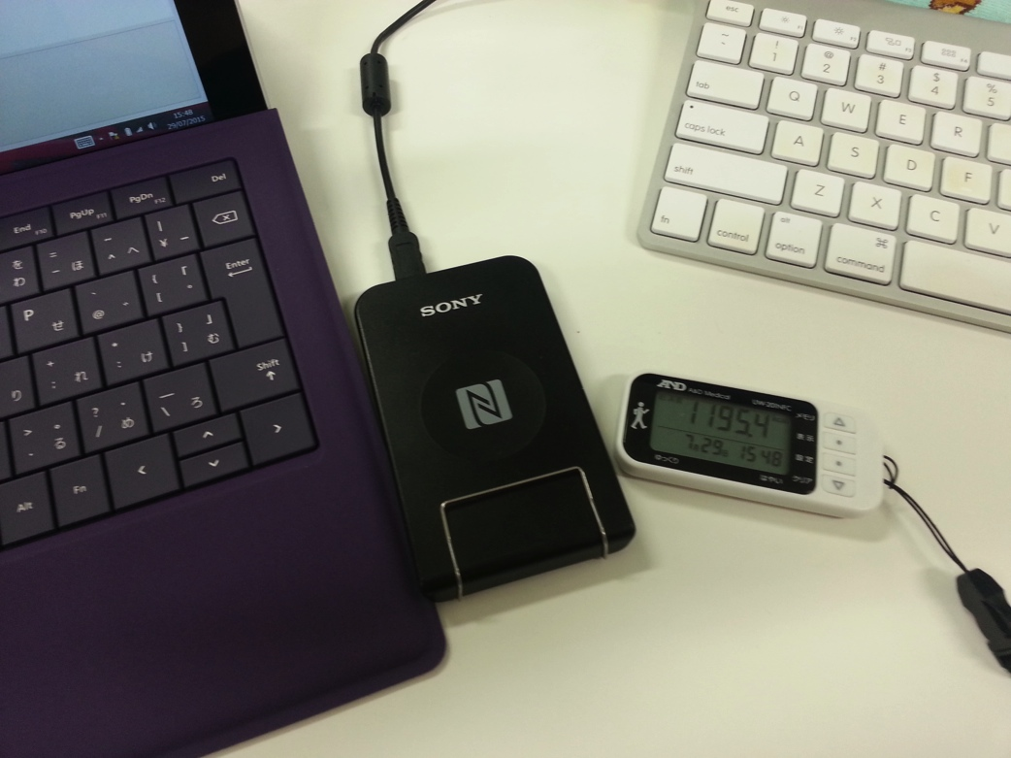
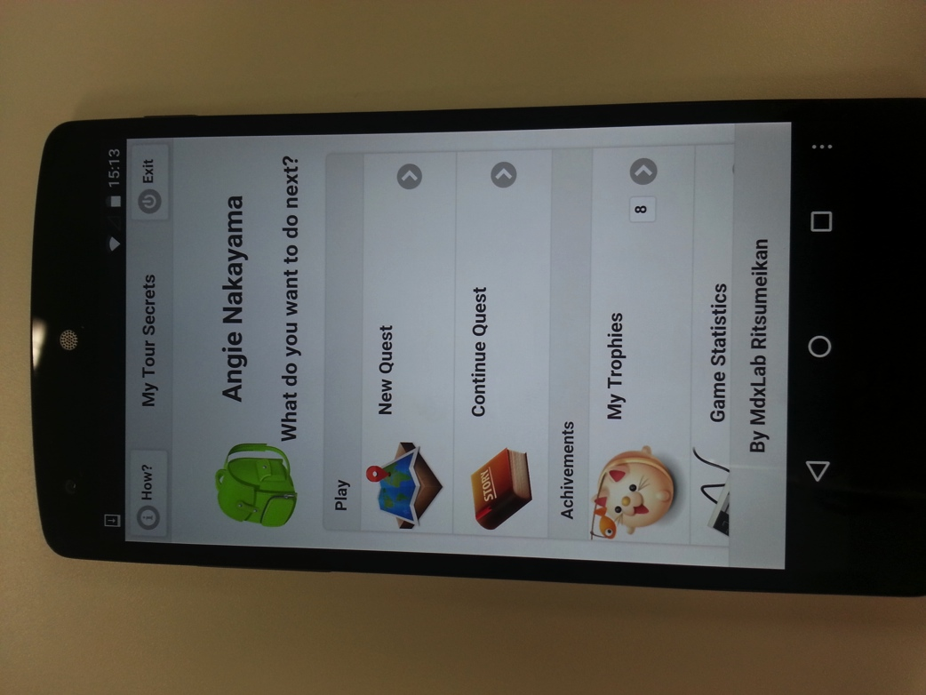
NFC Pedometer
Location Based Social Game for Tourists
for Tekupeko project

Slide 3

NFC Pedometer for Tekupeko walking project
Tekupeko is a project for making people walk more using mobile technologies (smartphones).
This project was developed in Multimedia Experience Laboratory (by Suzuki san and Wakao san) it was used last year (and also this year) on a walking for health event.
Android and iPhone app already developed and in phase of redesign and improvement.
There is also a webpage where you can register and see your progress, make teams, etc.

Slide 4
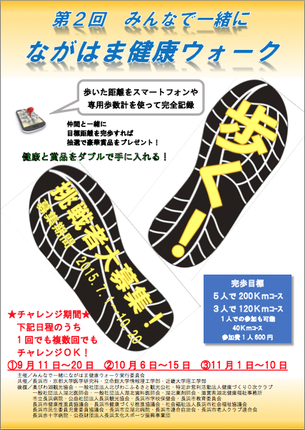
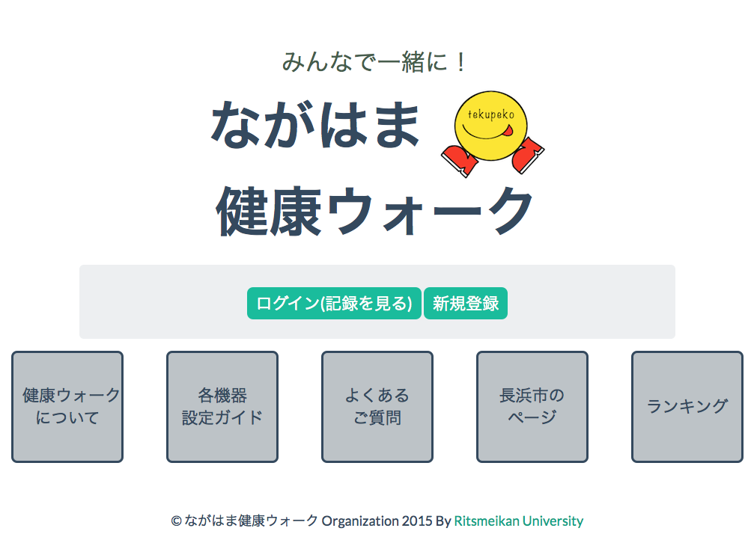
Web page and event promotion flyer

Slide 5

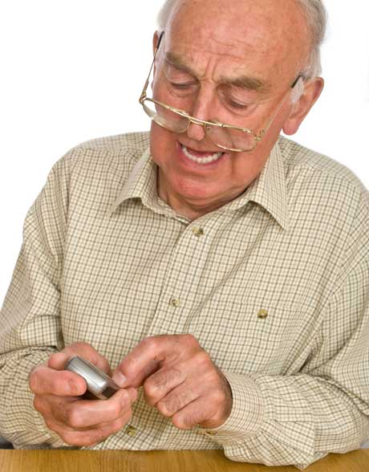
But what about people without smartphones?
Older people, kids, etc. How can they participate on this event????

Slide 6
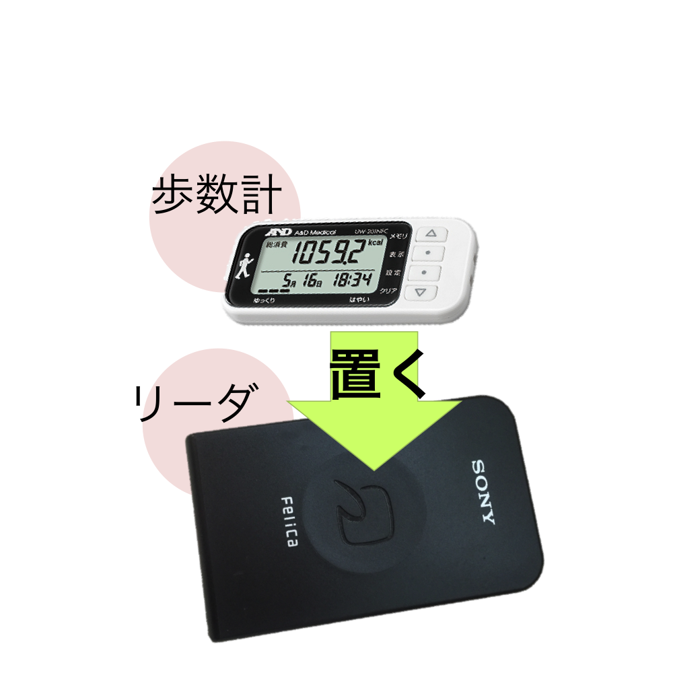
The solution: NFC Pedometer
By using a NFC pedometer we can make this people to enter the event.
No need to buy a expensive device and learn complicated things to use it.
Just carry the device on their pocket and go to registration point once a while.
Using NFC technology we can transfer walking data from pedometer to the event website.

Slide 7
Design & Technology
General project diagram
Chosen hardware
NFC Type 3 Dynamic Tag (Sony’s FeliCa)
Programing Technologies (Python, C++, Sony Health Library, git commands)
Implementacion inicial y problemas que se tuvieron
Usando libreria de sony y nuevo disenio
Pantallas

Slide 8
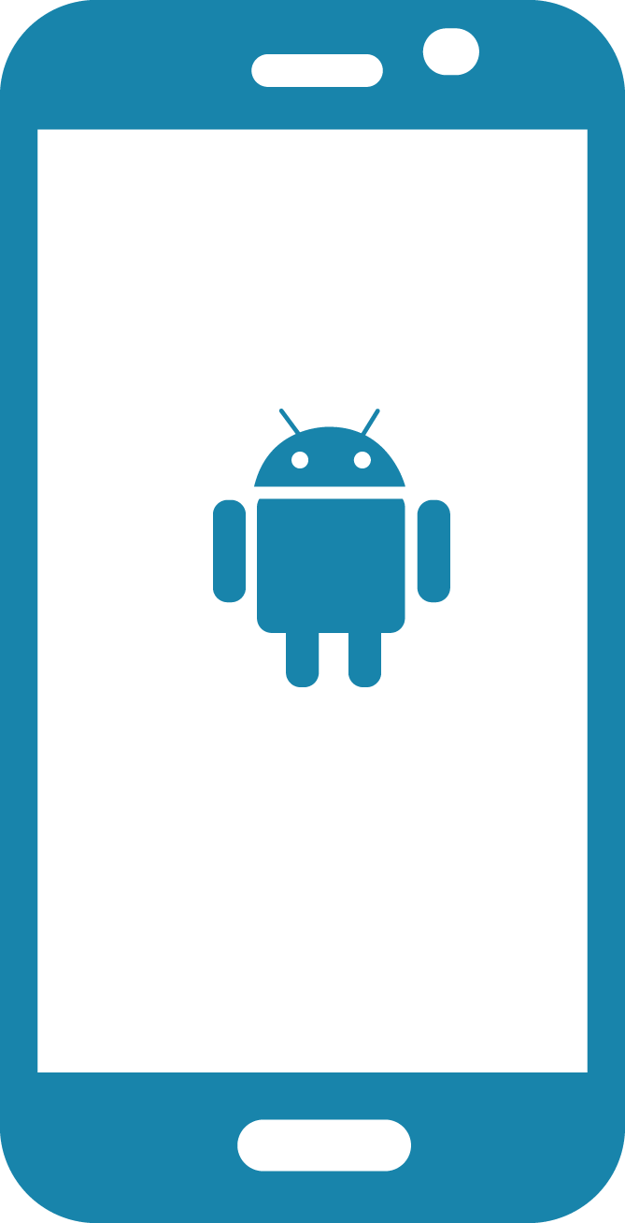



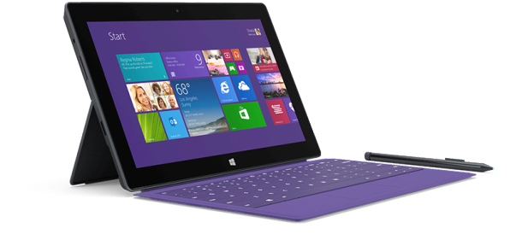
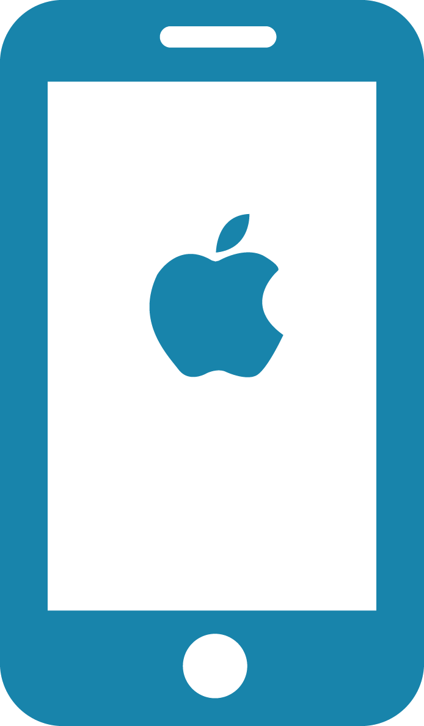
Django
Tekupeko server
Pedometer
Reader
Android
Tekupeko app
Moves Relay App
GIT
Server
Moves
Server
YAML
File
PC app

Slide 9
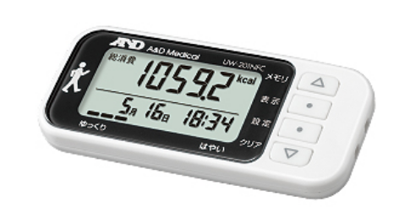
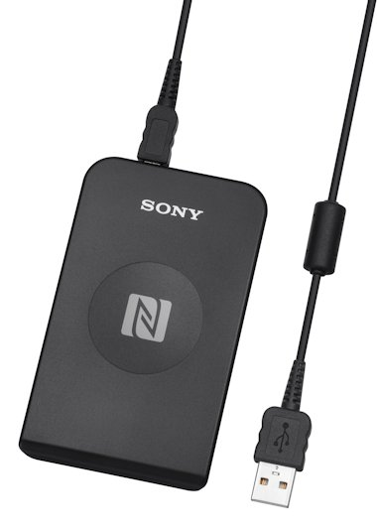
Hardware
NFC Pedometer
A&D Medical UW-201NFC
NFC reader
Sony RC-S380
PC
Windows Surface Pro 3

Slide 10

NFC
NFC (Near field Communication) is the set of protocols that enable electronic devices to establish radio communication with each other by touching the devices together, or bringing them into proximity to a distance of typically 10cm or less
Each full NFC device can work in three modes:
NFC Card emulation mode enables NFC-enabled devices such as smartphones to act like smart cards, allowing users to perform transactions such as payment or ticketing.
NFC Reader/writer mode enables NFC-enabled devices to read information stored on inexpensive NFC tags embedded in labels or smart posters.
NFC peer-to-peer (P2P) mode enables two NFC-enabled devices to communicate with each other to exchange information in an adhoc fashion
Notes:
The first thing to do is understand how NFC works, the type of device and reader we have to work with.
For sony reader and A&D pedometer is needed to understand Felica and Type 3 tag

Slide 11
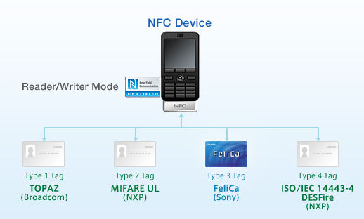
NFC Tags
NFC tags typically contain data and are read-only, but may be rewritable. NFC tags can be custom-encoded by their manufacturers or use the industry specifications provided by the NFC Forum.
NFC Forum defines 4 distinct types of tags that provide different communication speeds and capabilities in terms of flexibility, memory, security, data retention and write endurance.
Type 3 Tag is based on the Japanese Industrial Standard (JIS) X 6319-4. This tag type is pre-configured at manufacture to be either read and re-writable, or read-only. Example: Sony Felica

Slide 12
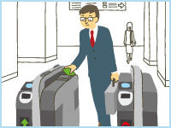

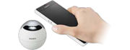
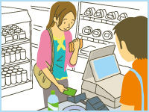
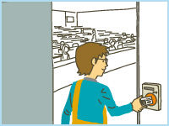
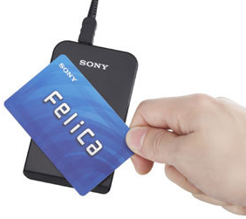

Sony FeliCa & PaSoRi
FeliCa is a contactless RFID smart card system from Sony in Japan, used in e-money, public transportation, and student id cards (ICCOCA, Suica, Manaca, PiTaPa, etc.) as well as in consumer electronics.
The name stands for Felicity Card
Sony has an external USB FeliCa PC reader/writer called PaSoRi. (Sony RC-S380)

Slide 13
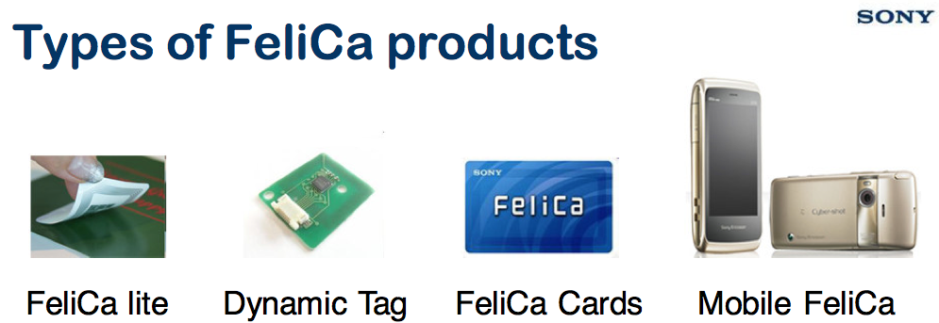
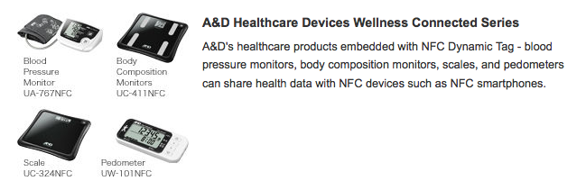
A&D NFC Pedometer
UW-201NFC
Notes:
NFC Dynamic Tag is a wireless-interface product, which can be embedded into electronic devices, enabling the device to communicate with any NFC reader/writer or with any NFC smartphone
http://www.sony.net/Products/felica/casestudy/healthcare.html

Slide 14
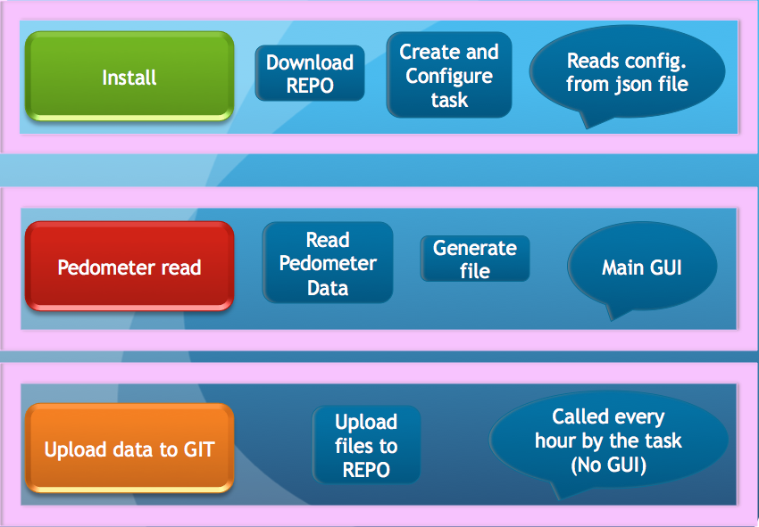
General design

Slide 15
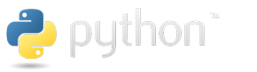



Programing
Python (Programing language)
NFCPY Library for Python and NFC (open source)
Git (Version Control System)
NFC Port Software (Sony Driver for RC-S380 freeware)
SDK for NFC Starter Kit (Sony freeware)
NFC Healthcare Library (Sony under request and registration )

Slide 16

Initial development
Python 2.7 (Anaconda distribution),
Python libraries (pyside, QtPy, nfcpy, libusb, apscheduler
Git command prompt
NFC driver using libusb-win32

Slide 17
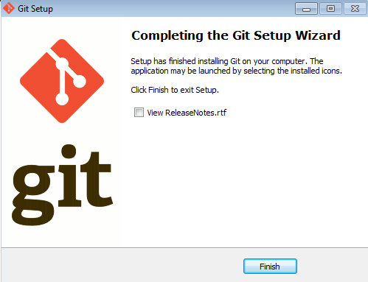
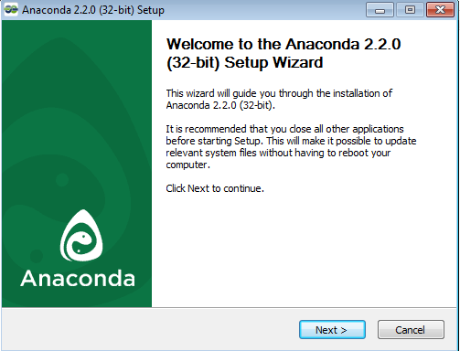
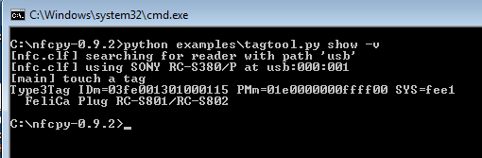
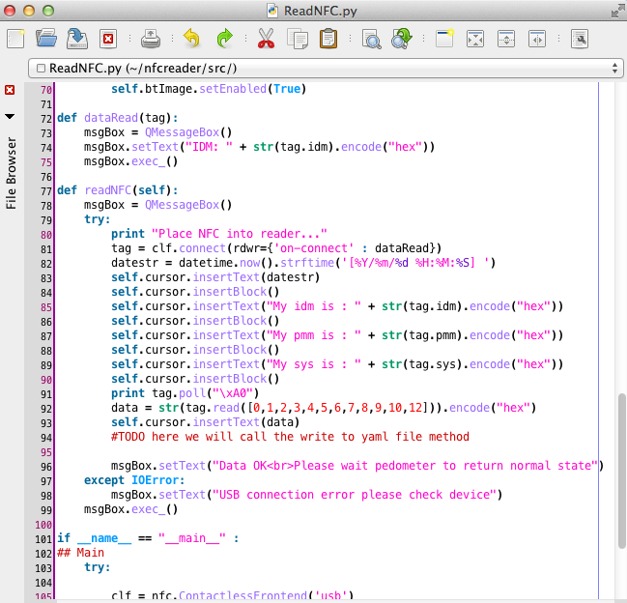
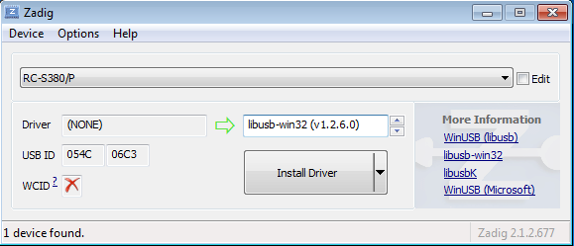
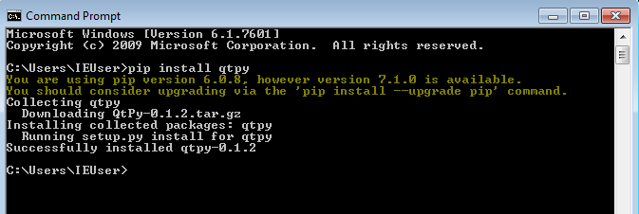

Slide 18
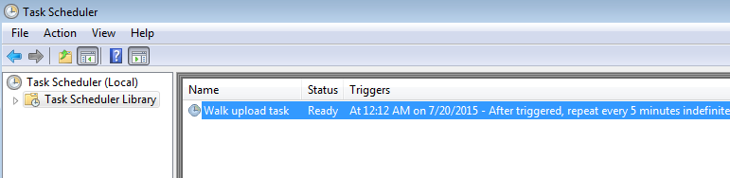
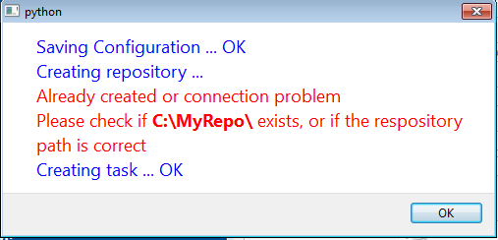
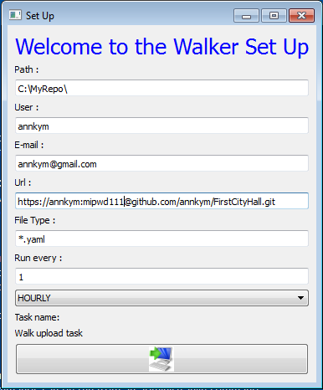
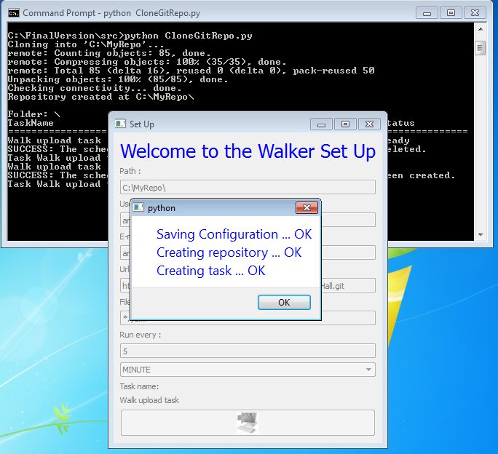

Slide 19
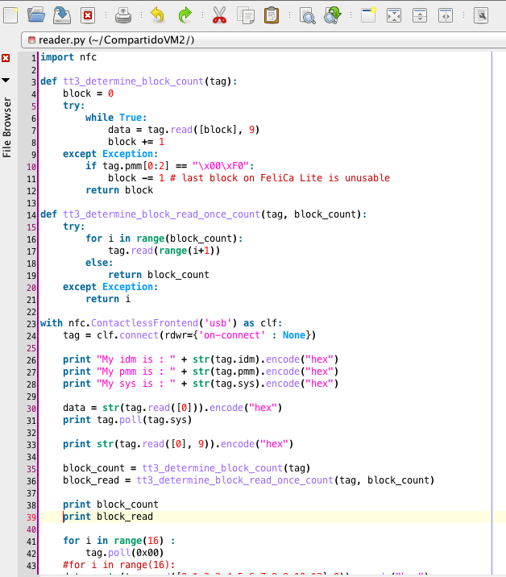
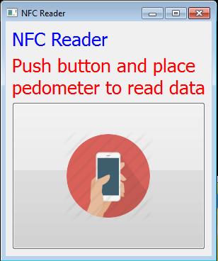

Slide 20
Testing
Virtual box
Virtual machine Windows 7 & 8
Final testing on Windows surface PRO 3 with Windows 8

Slide 21
LBG for tourism and sightseeing
https://en.wikipedia.org/wiki/Location-based_game
http://everybodywalk.org/documentary/

Slide 22
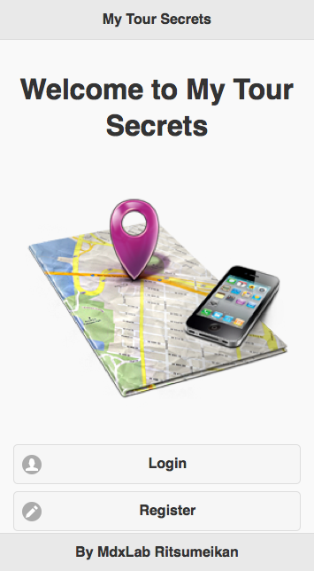
Welcome and logging
Pantallas y video y/o demo

Slide 23
Design &Technology
HTML 5
Phonegap
Jquery & Jquery Moblile
Phonegap Build
Google Maps appi for JS

